Slide 1
Exploratory Data Analysis project : Exploring UGC Graduate Salaries
Group 10
IP Ho Ming, IP

Slide 2
Agendar
Project Objectives
Introduction of Dataset
Findings
Challenges and Limitations
Conclusion
Reference (e.g. dataset)

Slide 3
Project Objectives
The objective of this project is to analyze and explore the UGC graduate salaries by considering the level of study and broad academic program categories to gain insights into salary variations.

Slide 4
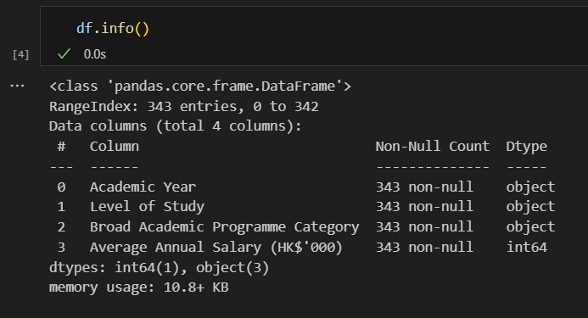
Introduction of Dataset
4 columns
343 rows
Data types match Data Dictionaries

Slide 5
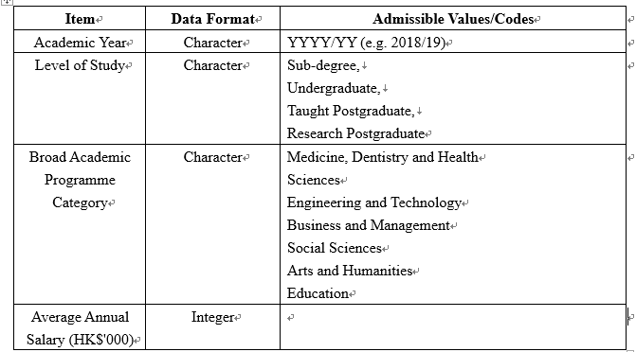
Introduction of Dataset:Data Dictionary
Notes:教學型的碩士(Postgraduate Taught), 研究型碩士(Postgraduate Research)

Slide 6
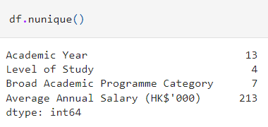
Introduction of Dataset:Data Dictionary and data quality
Data dictionary:
Check the unique values of each column
match with data dictionary to ensure data consistency

Slide 7
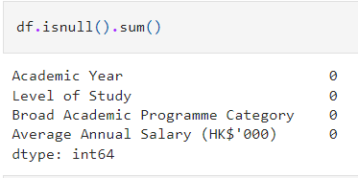
Introduction of Dataset: missing values
Check if there are missing values

Slide 8
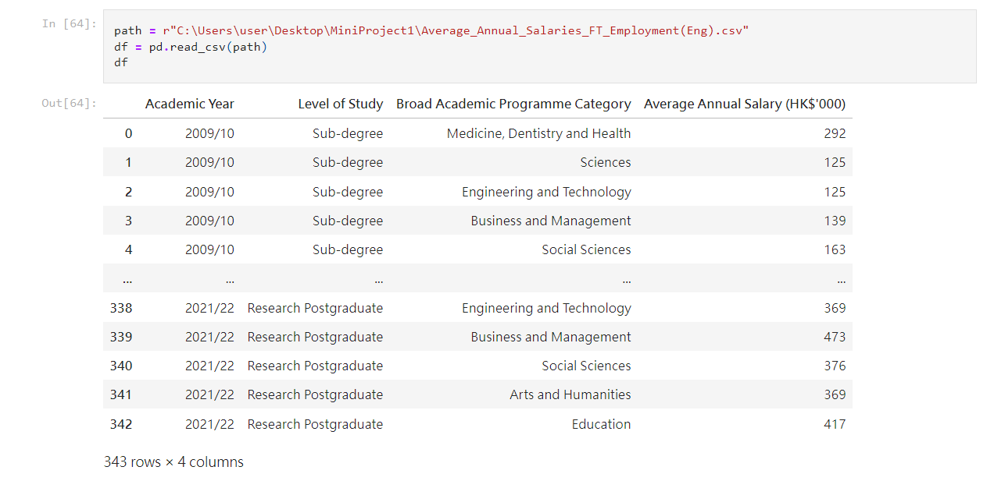
Introduction of Dataset

Slide 9
Findings:during 2019/10 to 2021/22,Average Annual Salary by Broad Academic Programme Categories

Slide 10
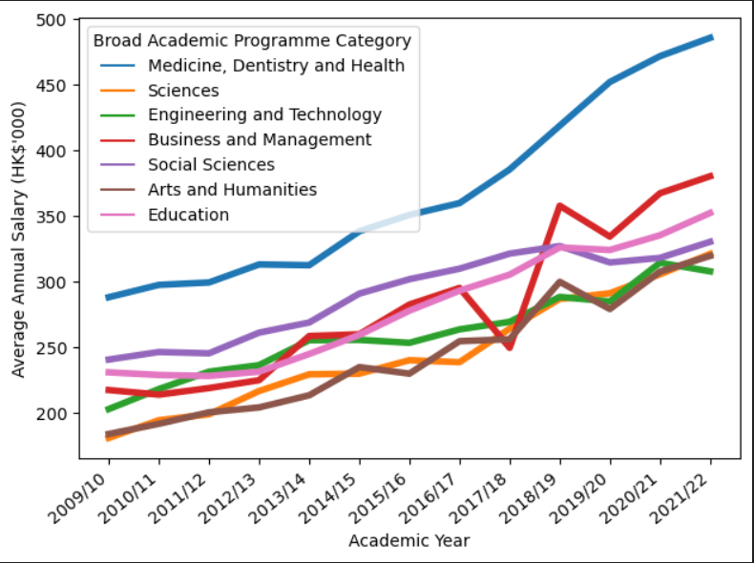
Findings 1:Business and Management salaries fluctuate
From 2017/18 to 2018/19 salaries increased rapidly.
First excessed Social sciences and Education at 2018/2019.Become the second most earned salary.

Slide 11
Findings 2:Medicine, Dentistry and Health , highest annual salary
Medicine, Dentistry and Health has the highest annual salary among all programmes.
Salary gap is getting larger
Notes:
covid-19 started at 2019 December
social event 2019
academic year :begins in August and ends in June

Slide 12
Findings 3:Education’s salary increase stably
Education’s salary increase stably.
Excessed social sciences at 2018/19.
The third most earned programme.
Notes:
covid-19 started at 2019 December
social event 2019
academic year :begins in August and ends in June

Slide 13
Findings 4:Social Sciences salary slightly decrease
Social Sciences salary started decrease in 2018/19 and increase slowly in recent year.
Rank fourth among all programs.
Notes:
covid-19 started at 2019 December
social event 2019
academic year :begins in August and ends in June

Slide 14
Findings 5:Arts and Humanities , Sciences , Engineering and Technology
Salary gap is very small in recent years among these three categories.
Engineering and Technology,
the only one recoded a drop at 2020/21.
Notes:
covid-19 started at 2019 December
social event 2019
academic year :begins in August and ends in June

Slide 15
Findings:Average Annual Salary during 2019/10 to 2021/22 by Level of Study

Slide 16
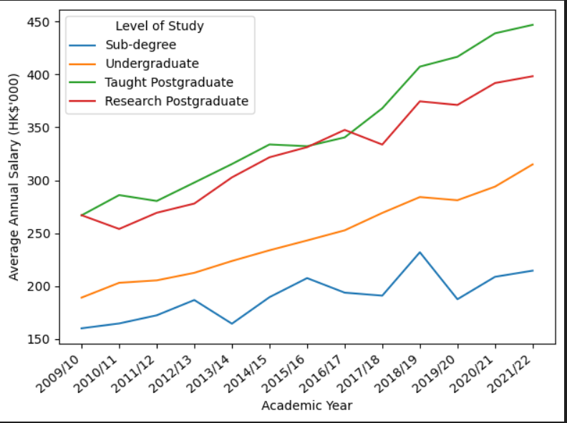
Average Annual Salary during 2019/10 to 2021/22 by Level of Study
Salary gap between :
Postgraduate and Undergraduate
Undergraduate and Sub-degree

Slide 17
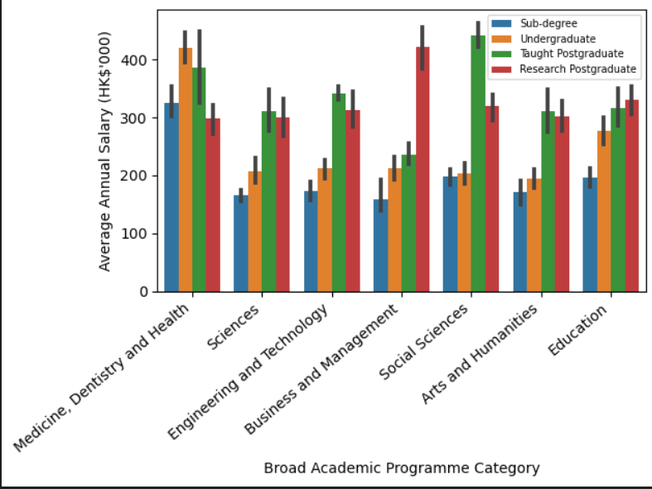
Average Annual Salary during 2019/10 to 2021/22 by Level of Study and Broad Academic Programme Category
Generally.higher level of study , higher average annual salary,except Medicine, Dentistry and Health.
For Business and Management and Social Sciences, postgraduates’ average annual salary is a lot higher than undergraduates and sub-degree holders.

Slide 18
Challenges and Limitations

Slide 19
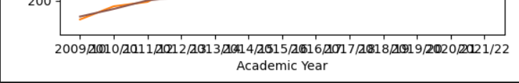
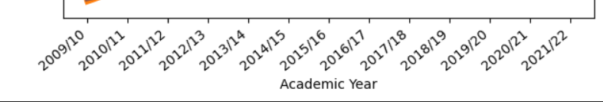
Challenges and Limitations
Problem : X axis could not display properly
Solution: rotate the value

Slide 20
Challenges and Limitations
Broad Academic Programme Category can be more specific:
e.g. Subcategories within social science include sociology, psychology, economics, political science, anthropology, etc.
If it is possible to obtain subcategories data, it will gain more specific insights into salary variations

Slide 21
Conclusion

Slide 22
Conclusion
Business and Management salaries fluctuate
Medicine, Dentistry and Health , highest annual salary
Education’s salary increase stably
Salary gap is very small in recent years among Arts and Humanities , Sciences , Engineering and Technology
Generally.higher level of study , higher average annual salary,

Slide 23
Reference
Dataset obtained from :
https://data.gov.hk/en-data/dataset/hk-ugc-ugc-average-annual-salaries-graduates
More details for the project on Github:
https://github.com/IPHOMING/EDA_Project

